Slide 1
Exploring the Influence of Font Style, Size, and Medium on Text Comprehension: A 2³ Factorial Design Experiment
By: Michael Okanta, Simon Atoyire, and Thao Nguyen

Slide 2
Outline
Introduction
Experimental Setup
Findings and Discussion
Conclusion
Recommendation

Slide 3
Introduction
Students now have two options for accessing and utilizing course materials: through traditional paper formats or digitally. However, which format helps students study more effectively is still a hotly debated topic.
Moreover, how the presentation elements, such as font style and font size, impact student learning is also an interesting question that is of much interest to scholars.
Varied research findings
No effect - Ali et al (2013); Florit et al (2023); Hermena et al. (2017)
Significant effect - Dressler (2019) ; Ralekar et al. (2018); Rello et al (2016)
By analyzing empirical data and theoretical frameworks, this study investigates how font style, font size, and medium impact students’ ability to comprehend text effectively.

Slide 4
Experimental Setup
Experiment design: 2³ factorial design with 3 replicates
Factor 1: Font Style (Calibri vs Times New Roman)
Factor 2: Font Size (10 pts vs 12 pts)
Factor 3: Medium (Paper vs Computer)
Participants: 3 Miami University students with varying educational and cultural backgrounds
Procedure:
Experiment was conducted at King Library
For each run, each participant received a text passage with a random combination of font style, font size, and medium to read in 5 minutes
After 5 minutes, participants were given a set of 10 questions based on the text passage to assess understanding of its content
The number of correct answers for each participant for each round was recorded for analysis
Experiment consisted of 8 runs, each corresponding to a different text passage
Analysis: Excel (Data organization and Storage); SAS 9.4 (Data Analysis)

Slide 5
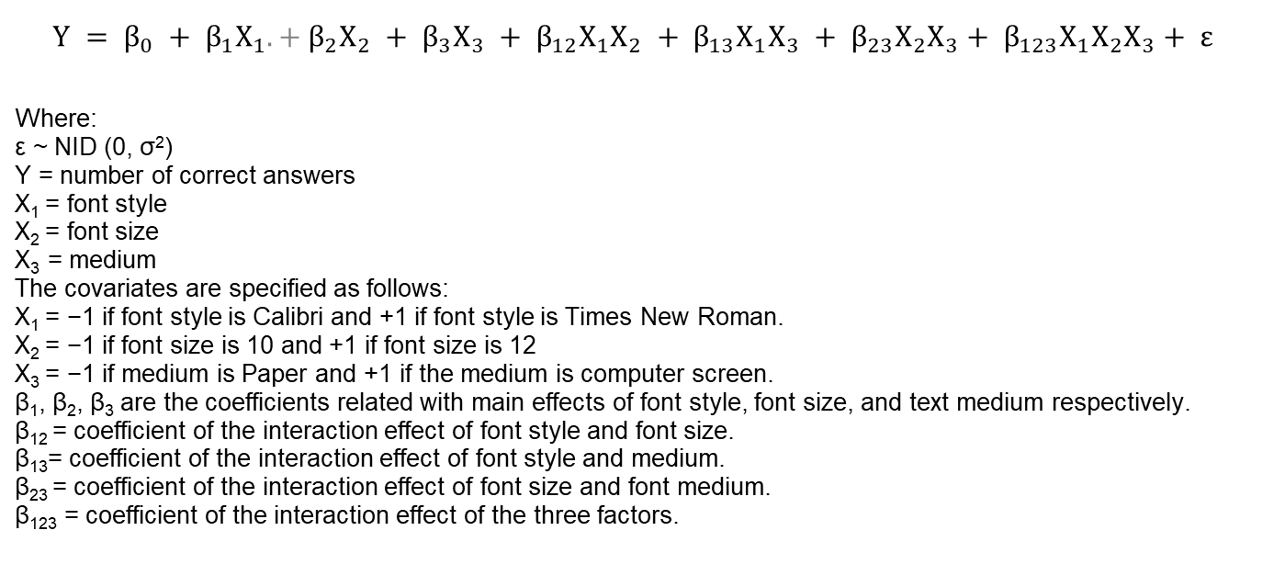
Model Equation
$$Y = β_{0} + β_{1}X_{1}.+ β_{2}X_{2} + β_{3}X_{3} + β_{12}X_{1}X_{2} + β_{13}X_{1}X_{3} + β_{23}X_{2}X_{3}+ β_{123}X_{1}X_{2}X_{3}+ ε$$
Where:
ε ~ NID (0, σ²)
Y = number of correct answers
X₁ = font style
X₂ = font size
X₃ = medium
The covariates are specified as follows:
X₁ = −1 if font style is Calibri and +1 if font style is Times New Roman.
X₂ = −1 if font size is 10 and +1 if font size is 12
X₃ = −1 if medium is Paper and +1 if the medium is computer screen.
β₁, β₂, β₃ are the coefficients related with main effects of font style, font size, and text medium respectively.
β₁₂ = coefficient of the interaction effect of font style and font size.
β₁₃= coefficient of the interaction effect of font style and medium.
β₂₃ = coefficient of the interaction effect of font size and font medium.
β₁₂₃ = coefficient of the interaction effect of the three factors.

Slide 6
Findings and Discussion

Slide 7
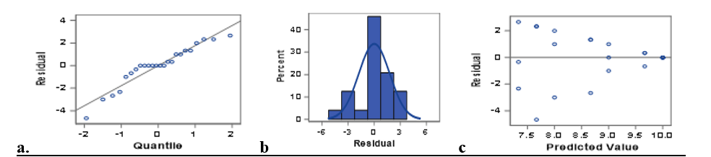
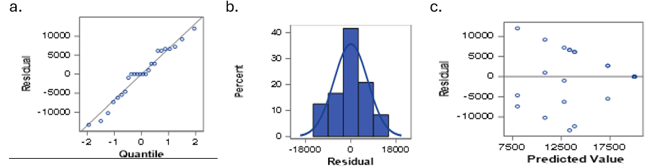
Figure 1: Residual Plots for Original Data
Figure 2: Residual Plots for Box-Cox Transformed Data

Slide 8
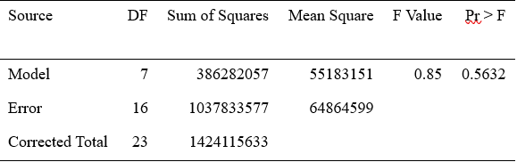
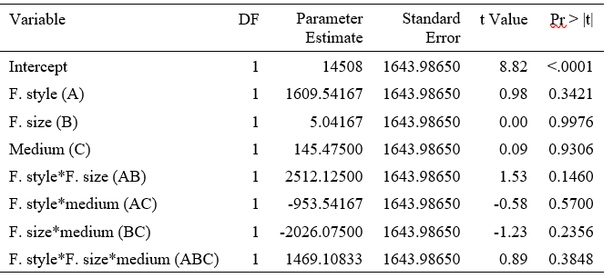
Table 1: Anova Table
Table 2: Parameter Estimates

Slide 9
Conclusion
Through our experiment, we discovered that font style, font size, and medium don’t have significant effect on how students comprehend text.
Theoretical Framework: Cognitive Load Theory (CLT)
The ability of students to understand texts might depend more on other factors rather than the nature of the text and the medium through which it is presented.
According to germane and intrinsic aspects of the CLT, the comprehension ability depends more on students’ efforts and their previous knowledge of subject matter (Sweller, 2010; Sweller, 1988).

Slide 10
Recommendations
Practice
It is thus recommended that students should commit more effort into studying their lecture materials irrespective of the characteristics of the texts or the medium in which they presented.
Educators and publishers must ensure consistency and continuation in study materials in subsequent levels.
Future Research
Future studies are recommended to explore this topic further with a larger sample size to obtain a more informative result.
Further research could be conducted by using complex and familiar topics to examine the topic in different familiarity contexts.

Slide 11
References
Ali, A. Z. M., Wahid, R., Samsudin, K., & Idris, M. Z. (2013). Reading on the Computer Screen: Does Font Type Have Effects on Web Text Readability?. International Education Studies, 6(3), 26-35.
Dressler, E. (2019). Understanding the effect of font type on reading comprehension/memory under time-constraints.
Florit, E., De Carli, P., Rodà, A., Domenicale, S., & Mason, L. (2023). Precursors of reading text comprehension from paper and screen in first graders: a longitudinal study. Reading and Writing, 36(7), 1821-1843.
Hermena, E. W., Sheen, M., AlJassmi, M., AlFalasi, K., AlMatroushi, M., & Jordan, T. R. (2017). Reading rate and comprehension for text presented on tablet and paper: Evidence from Arabic. Frontiers in psychology, 8, 257.
Ralekar, C., Saha, P., Gandhi, T. K., & Chaudhury, S. (2018). Effect of devanagari font type in reading comprehension: An eye tracking study. In Intelligent Human Computer Interaction: 10th International Conference, IHCI 2018, Allahabad, India, December 7–9, 2018, Proceedings 10 (pp. 136-147). Springer International Publishing.
Rello, L., Pielot, M., & Marcos, M. C. (2016, May). Make it big! The effect of font size and line spacing on online readability. In Proceedings of the 2016 CHI conference on Human Factors in Computing Systems (pp. 3637-3648).
Sweller, J. (1988). Cognitive load during problem solving: Effects on learning. Cognitive science, 12(2), 257-285.
Sweller, J. (2010). Element interactivity and intrinsic, extraneous, and germane cognitive load. Educational psychology review, 22, 123-138.

Slide 12
THANK YOU FOR LISTENING!!

Slide 13
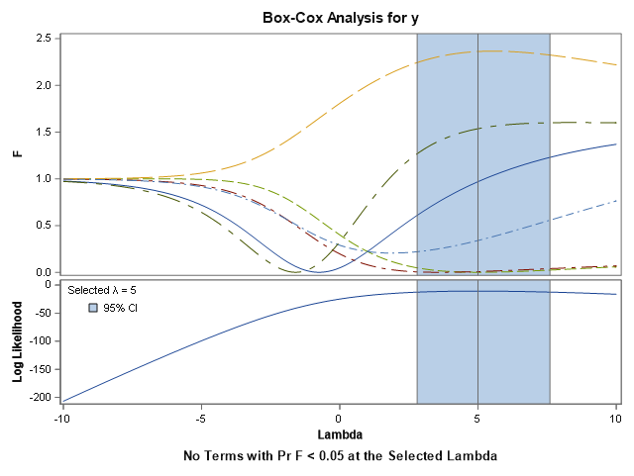
Appendix
Figure 1. Box-Cox Analysis for the Response Variable

Slide 14
